Slide 1
Control Flow and Function
2020/11/03
Hongfei Yan

Slide 2
Contents
1 Python Primer 1
1.1 Python Overview.2
1.2 Objects in Python.4
1.3 Expressions, Operators, and Precedence.12
1.4 Control Flow 18
1.5 Functions 23
1.6 Simple Input and Output 30
1.7 Exception Handling.33
1.8 Iterators and Generators 39
1.9 Additional Python Conveniences 42
1.10 Scopes and Namespaces 46
1.11 Modules and the Import Statement 48

Slide 3
Program Structure
Common to all control structures, the colon character is used to delimit the beginning of a block of code that acts as a body for a control structure.
If the body can be stated as a single executable statement, it can technically placed on the same line, to the right of the colon.
However, a body is more typically typeset as an indented block starting on the line following the colon.
Python relies on the indentation level to designate the extent of that block of code, or any nested blocks of code within.

Slide 4
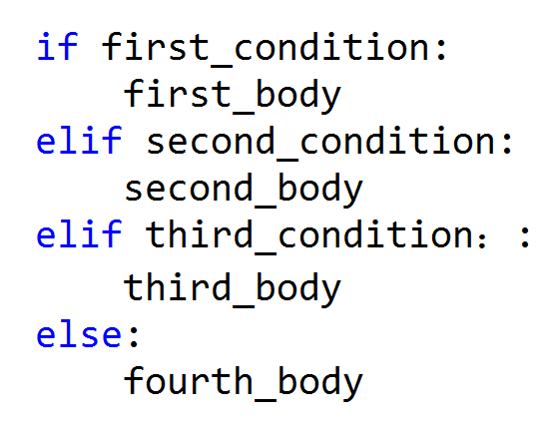
Conditionals

Slide 5
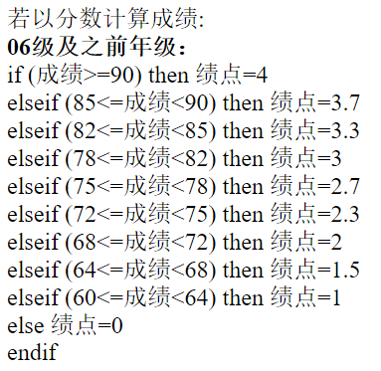
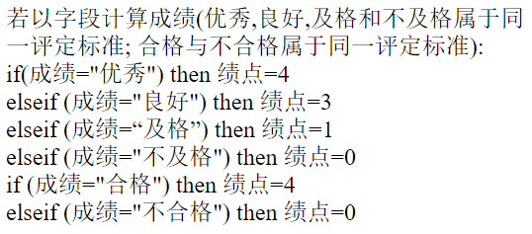
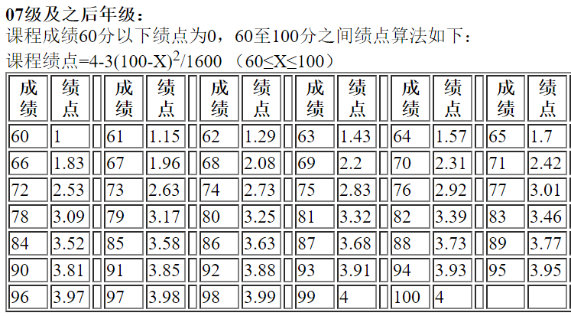
Notes:
http://net.pku.edu.cn/~course/on_exam/jd.html

Slide 6


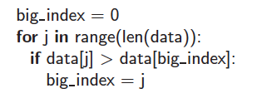
Loops
While loop:
For loop:
Indexed For loop:

Slide 7
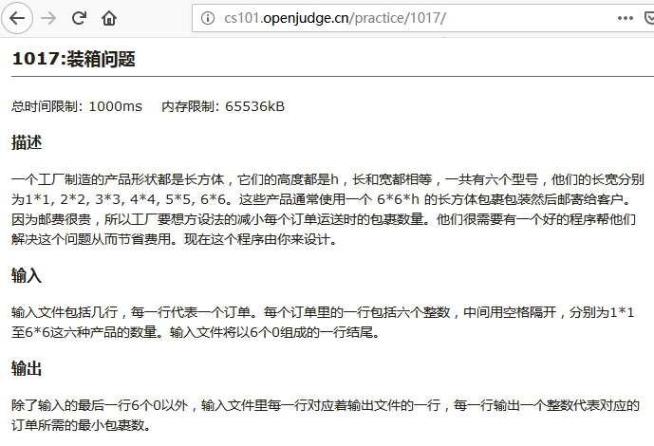
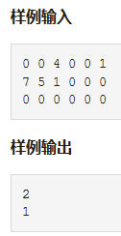
Notes:
http://cs101.openjudge.cn/practice/1017/

Slide 8
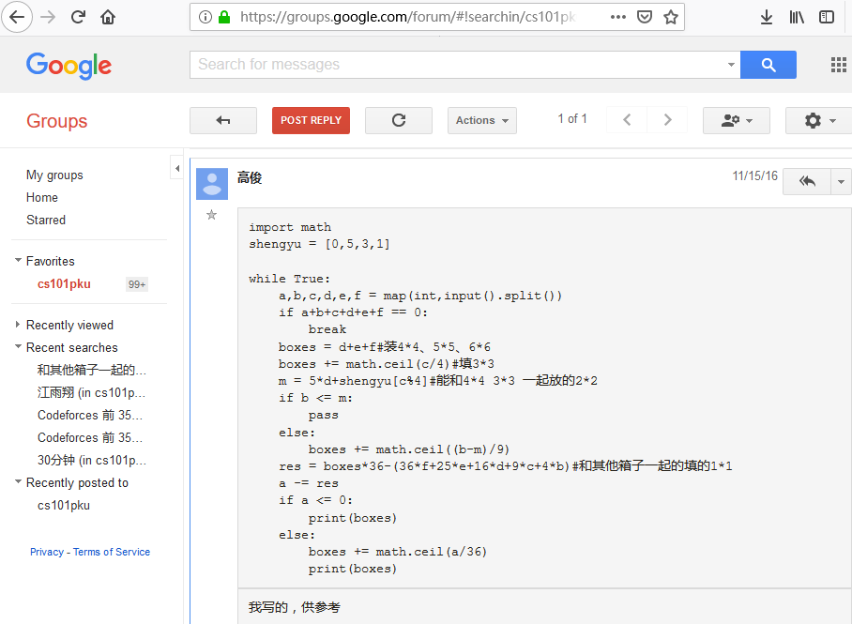
Notes:
# http://cs101.openjudge.cn/practice/1017/
import math
shengyu = [0,5,3,1]
while True:
a,b,c,d,e,f = map(int,input().split())
if a+b+c+d+e+f == 0:
break
boxes = d+e+f #装4*4、5*5、6*6
boxes += math.ceil(c/4) #填3*3
m = 5*d+shengyu[c%4] #能和4*4 3*3 一起放的2*2
if b <= m:
pass
else:
boxes += math.ceil((b-m)/9)
res = boxes*36-(36*f+25*e+16*d+9*c+4*b) #和其他箱子一起的填的1*1
a -= res
if a <= 0:
print(boxes)
else:
boxes += math.ceil(a/36)
print(boxes)

Slide 9
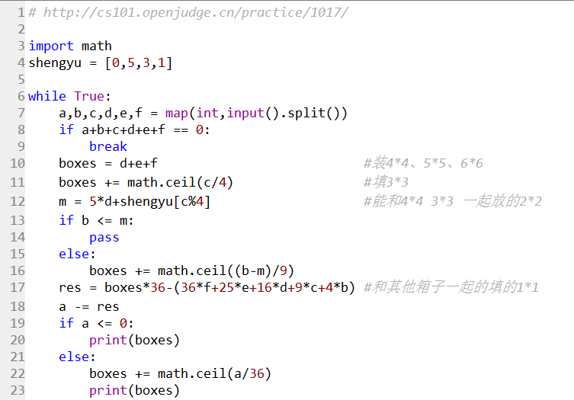

Slide 10
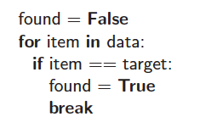
Break and Continue
Python supports a break statement that immediately terminate a while or for loop when executed within its body.
Python also supports a continue statement that causes the current iteration of a loop body to stop, but with subsequent passes of the loop proceeding as expected.

Slide 11
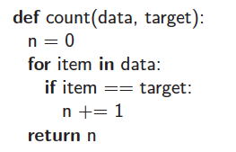
Functions
Functions are defined using the keyword def.
This establishes a new identifier as the name of the function (count, in this example), and it establishes the number of parameters that it expects, which defines the function’s signature.
The return statement returns the value for this function and terminates its processing.

Slide 12


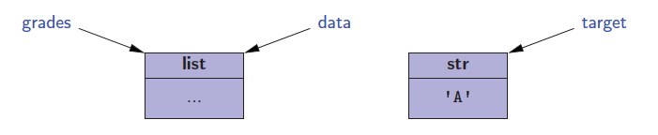
Information Passing
Parameter passing in Python follows the semantics of the standard assignment statement.
For example
is the same as
and results in

Slide 13
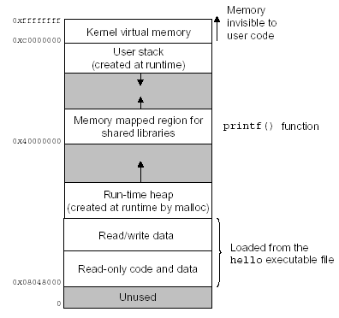

Slide 14
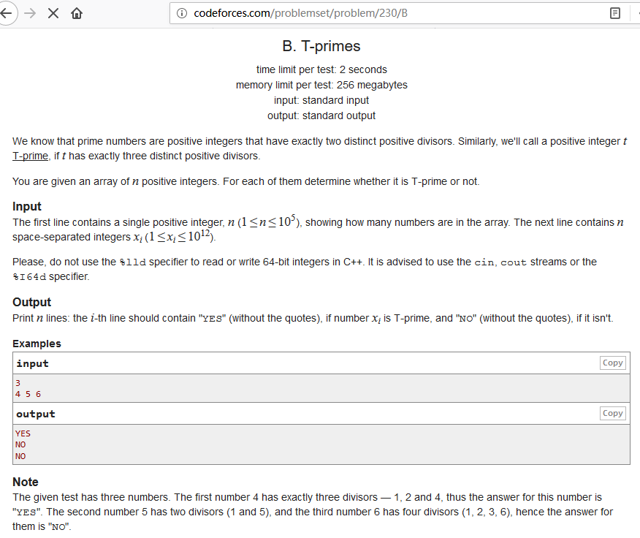
Notes:
http://codeforces.com/problemset/problem/230/B

Slide 15
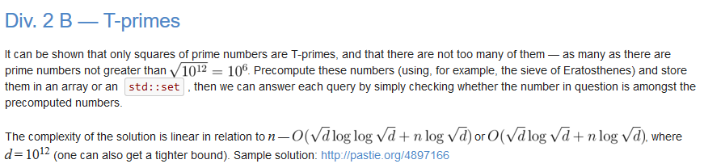

Slide 16
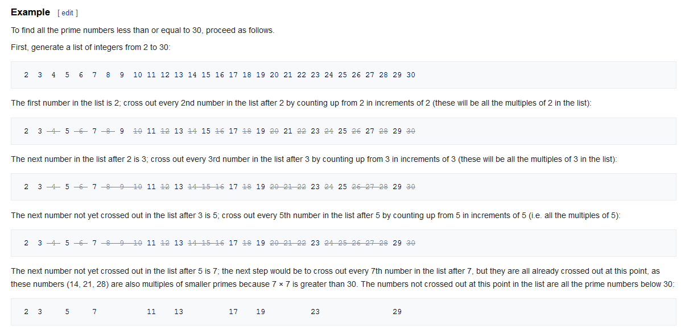
Notes:
有同学在做涉及质数问题，如 CF上面的230B。这个Sieve of Eratosthenes方法比较快（事先判断好），不会超时，

Slide 17
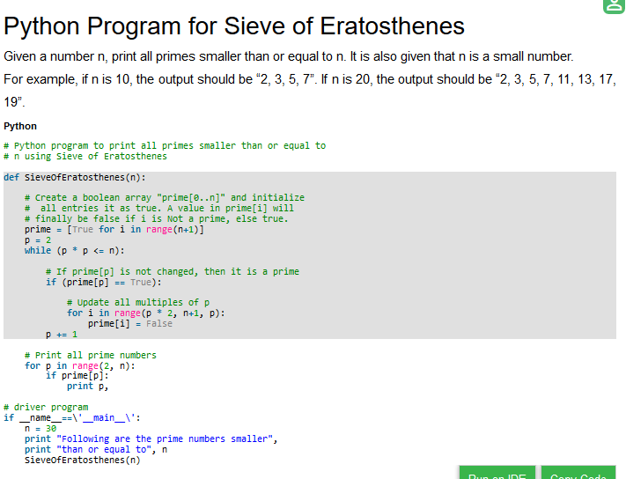
Notes:
https://www.geeksforgeeks.org/python-program-for-sieve-of-eratosthenes/

Slide 18
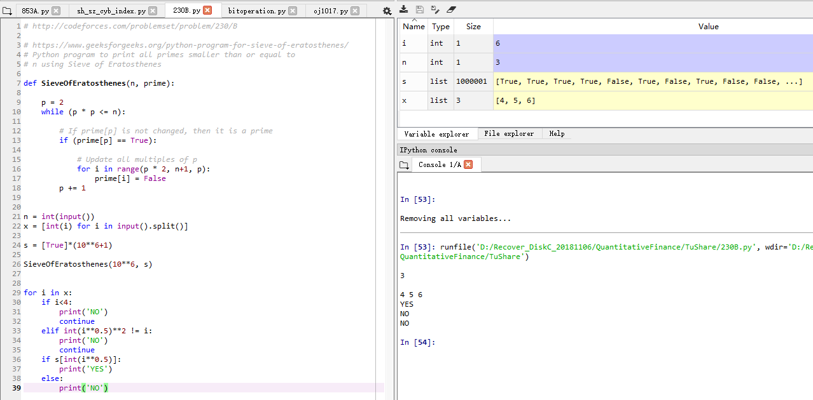
Notes:
# http://codeforces.com/problemset/problem/230/B
# https://www.geeksforgeeks.org/python-program-for-sieve-of-eratosthenes/
# Python program to print all primes smaller than or equal to
# n using Sieve of Eratosthenes
def SieveOfEratosthenes(n, prime):
p = 2
while (p * p <= n):
# If prime[p] is not changed, then it is a prime
if (prime[p] == True):
# Update all multiples of p
for i in range(p * 2, n+1, p):
prime[i] = False
p += 1
n = int(input())
x = [int(i) for i in input().split()]
s = [True]*(10**6+1)
SieveOfEratosthenes(10**6, s)
for i in x:
if i<4:
print('NO')
continue
elif int(i**0.5)**2 != i:
print('NO')
continue
if s[int(i**0.5)]:
print('YES')
else:
print('NO')

Slide 19
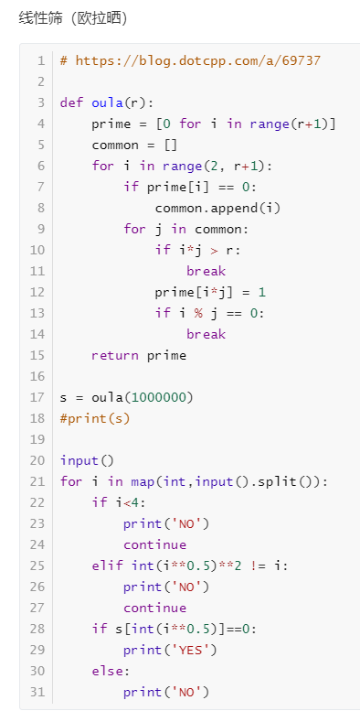
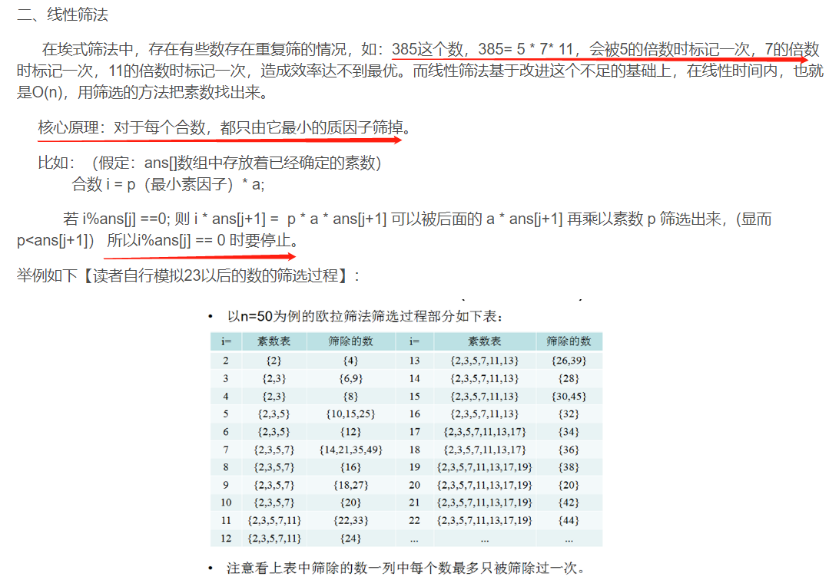
埃氏筛法和线性筛法求素数 https://blog.csdn.net/xuechen_gemgirl/article/details/79555123

Slide 20
Contents
1 Python Primer 1
1.1 Python Overview.2
1.2 Objects in Python.4
1.3 Expressions, Operators, and Precedence.12
1.4 Control Flow 18
1.5 Functions 23
1.6 Simple Input and Output 30
1.7 Exception Handling.33
1.8 Iterators and Generators 39
1.9 Additional Python Conveniences 42
1.10 Scopes and Namespaces 46
1.11 Modules and the Import Statement 48

Slide 21
Simple Output
The built-in function, print, is used to generate standard output to the console.
In its simplest form, it prints an arbitrary sequence of arguments, separated by spaces, and followed by a trailing newline character.
For example,
the command print(‘maroon’, 5) outputs the string ‘maroon 5\n’.
A nonstring argument x will be displayed as str(x).

Slide 22
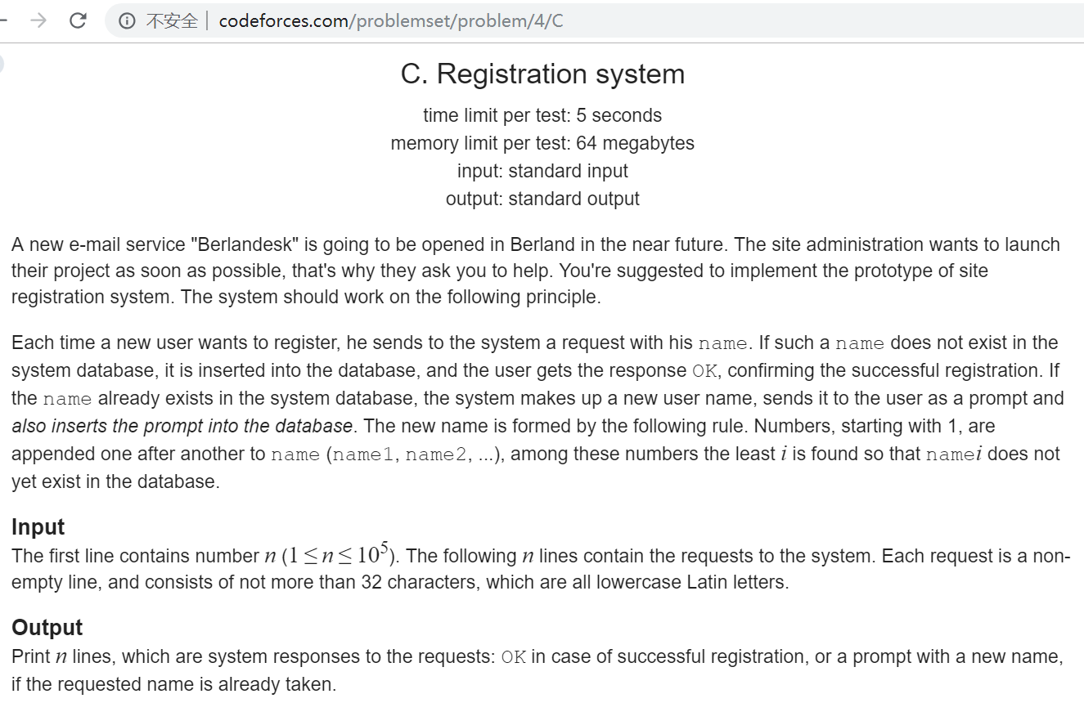
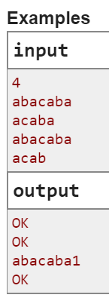
Notes:
http://codeforces.com/problemset/problem/4/C

Slide 23
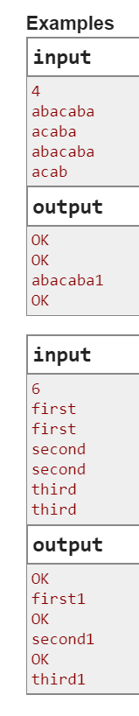
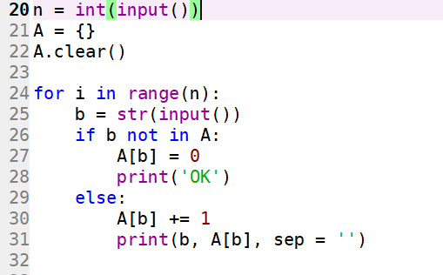
http://codeforces.com/problemset/problem/4/C
A = dict()

Slide 24
Simple Input
The primary means for acquiring information from the user console is a built-in function named input.
This function displays a prompt, if given as an optional parameter, and then waits until the user enters some sequence of characters followed by the return key.
The return value of the function is the string of characters that were entered strictly before the return key.
Such a string can immediately be converted, of course:

Slide 25
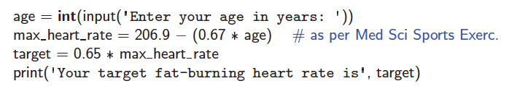
A Simple Program
Here is a simple program that does some input and output:
Notes:
A fat-burning heart rate is the optimum heat rate for burning calories of fat. This isn’t necessarily the highest heart rate that can be achieved during cardiovascular exercise. In fact, at lower intensities, a workout can burn a higher percentage of calories contained within fat. The exact fat burning heart rate depends on the age and resting heart beat of the individual although it is usually attained during medium intensity workouts.

Slide 26
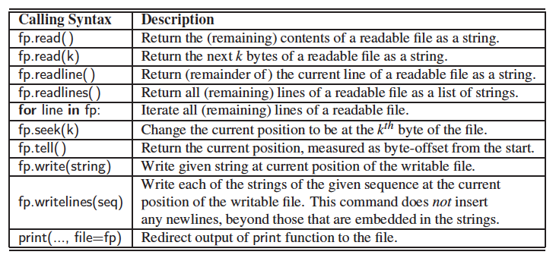
Files
Files are opened with a built-in function, open, that returns an object for the underlying file.
For example, the command, fp = open(‘sample.txt’), attempts to open a file named sample.txt.
Methods for files:

Slide 27
Exception Handling
Exceptions are unexpected events that occur during the execution of a program.
An exception might result from a logical error or an unanticipated situation.
In Python, exceptions (also known as errors) are objects that are raised (or thrown) by code that encounters an unexpected circumstance.
The Python interpreter can also raise an exception.
A raised error may be caught by a surrounding context that “handles” the exception in an appropriate fashion.
If uncaught, an exception causes the interpreter to stop executing the program and to report an appropriate message to the console.

Slide 28
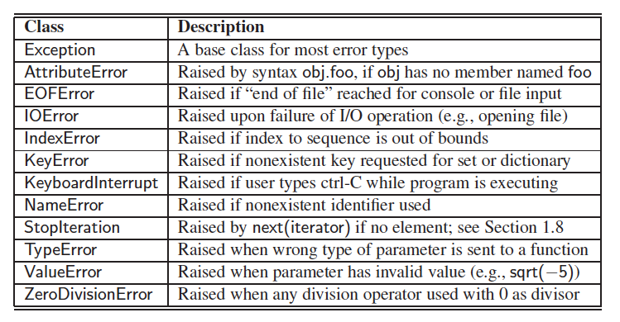
Common Exceptions
Python includes a rich hierarchy of exception classes that designate various categories of errors

Slide 29
Raising an Exception
An exception is thrown by executing the raise statement, with an appropriate instance of an exception class as an argument that designates the problem.
For example, if a function for computing a square root is sent a negative value as a parameter, it can raise an exception with the command:

Slide 30
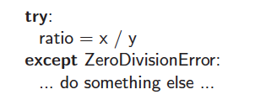
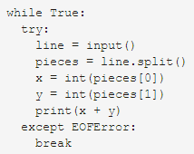
Catching an Exception
In Python, exceptions can be tested and caught using a try-except control structure.
In this structure, the “try” block is the primary code to be executed.
Although it is a single command in this example, it can more generally be a larger block of indented code.
Following the try-block are one or more “except” cases, each with an identified error type and an indented block of code that should be executed if the designated error is raised within the try-block.

Slide 31

Iterators
Basic container types, such as list, tuple, and set, qualify as iterable types, which allows them to be used as an iterable object in a for loop.
An iterator is an object that manages an iteration through a series of values.
If variable, i, identifies an iterator object,
then each call to the built-in function, next(i), produces a subsequent element from the underlying series,
with a StopIteration exception raised to indicate that there are no further elements.
An iterable is an object, obj, that produces an iterator via the syntax iter(obj).

Slide 33
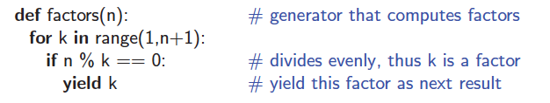
Generators
The most convenient technique for creating iterators in Python is through the use of generators.
A generator is implemented with a syntax that is very similar to a function, but instead of returning values, a yield statement is executed to indicate each element of the series.
For example, a generator for the factors of n:

Slide 34



Conditional Expressions
Python supports a conditional expression syntax that can replace a simple control structure.
The general syntax is an expression of the form:
This compound expression evaluates to expr1 if the condition is true, and otherwise evaluates to expr2.
For example:
Or even

Slide 35
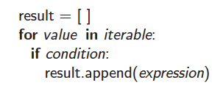
Comprehension Syntax
A very common programming task is to produce one series of values based upon the processing of another series.
Often, this task can be accomplished quite simply in Python using what is known as a comprehension syntax.
This is the same as
Notes:
http://bookshadow.com/weblog/2014/05/14/top-10-mistakes-that-python-programmers-make/
Comprehension 解析
http://python-3-patterns-idioms-test.readthedocs.org/en/latest/Comprehensions.html

Slide 36
If a programmer writes a loop such as for factor in factors(100):,

Slide 38

Packing
If a series of comma-separated expressions are given in a larger context, they will be treated as a single tuple, even if no enclosing parentheses are provided.
For example, consider the assignment
This results in identifier, data, being assigned to the tuple (2, 4, 6, 8). This behavior is called automatic packing of a tuple.

Slide 39

Unpacking
As a dual to the packing behavior, Python can automatically unpack a sequence, allowing one to assign a series of individual identifiers to the elements of sequence.
As an example, we can write
This has the effect of assigning a=7, b=8, c=9, and d=10.

Slide 40
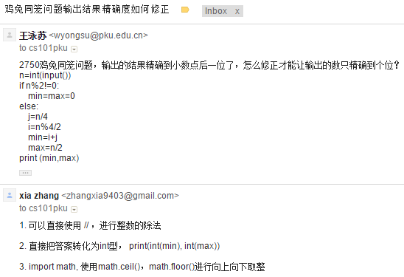

Modules
Beyond the built-in definitions, the standard Python distribution includes perhaps tens of thousands of other values, functions, and classes that are organized in additional libraries, known as modules, that can be imported from within a program.

Slide 41
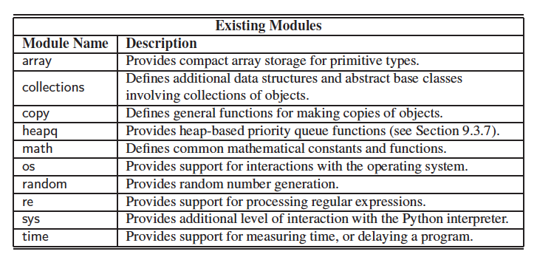
Existing Modules
Some useful existing modules include the following:

